Slide 1


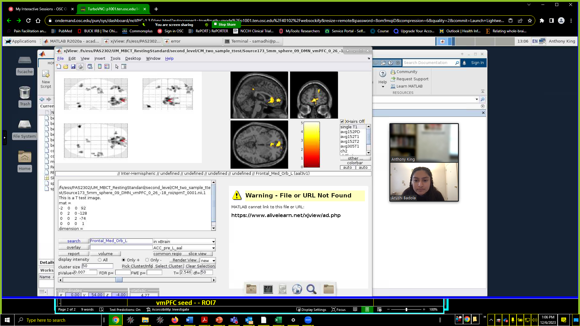
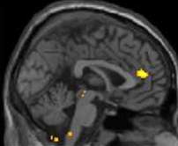
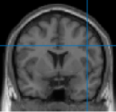
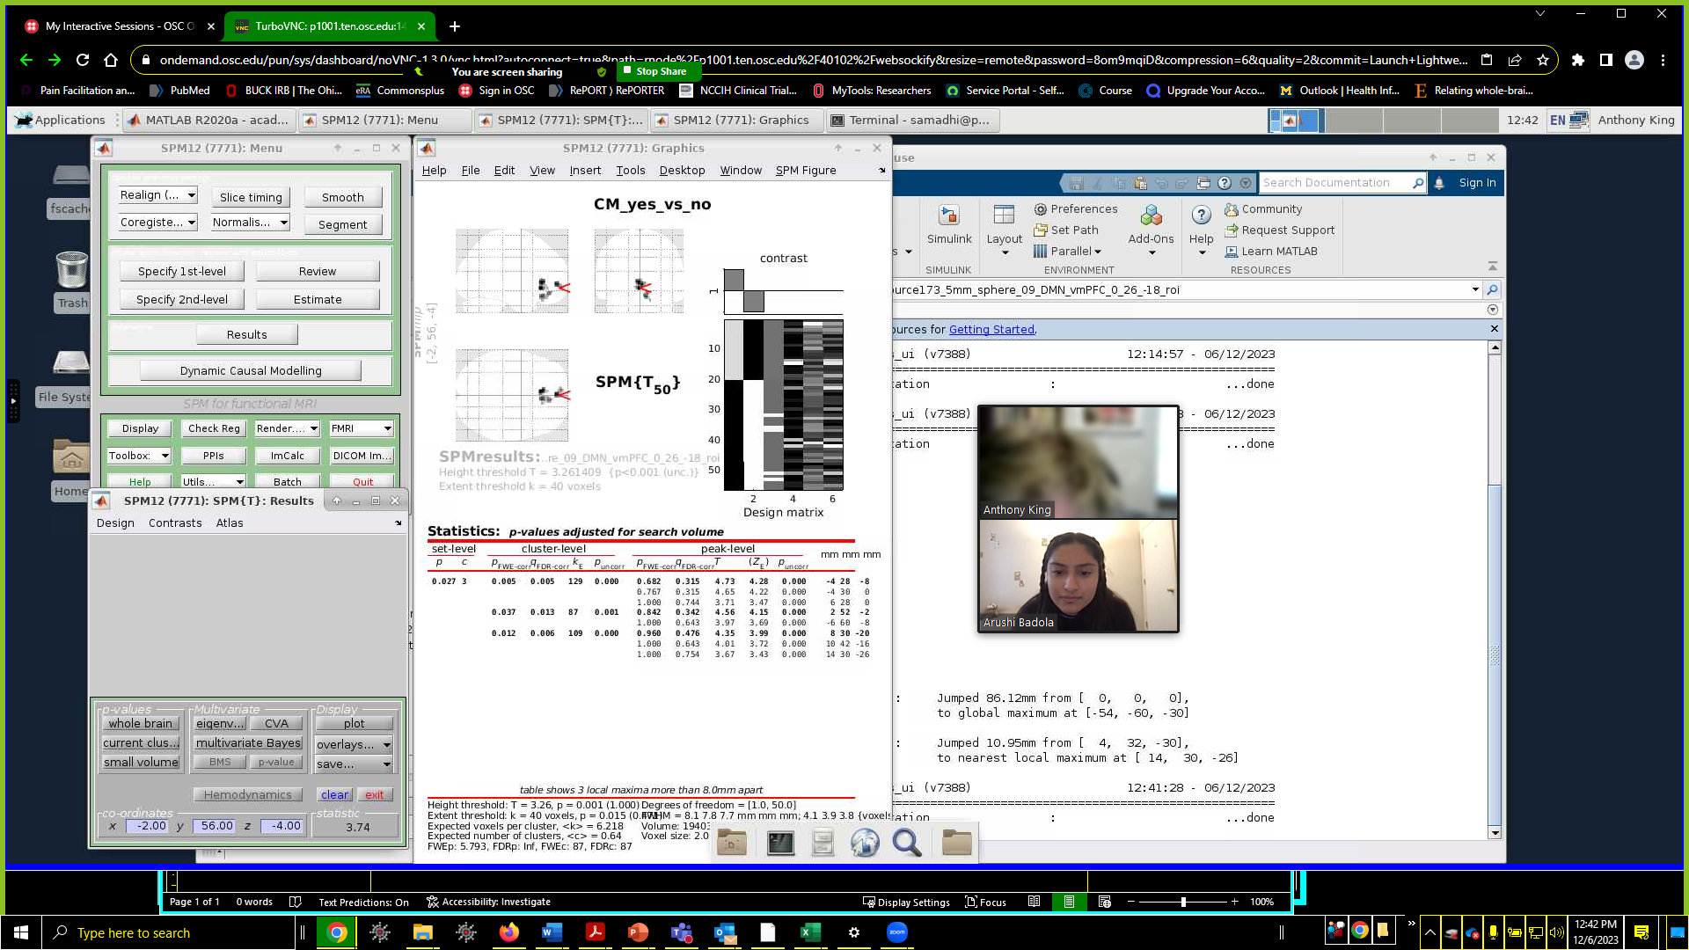
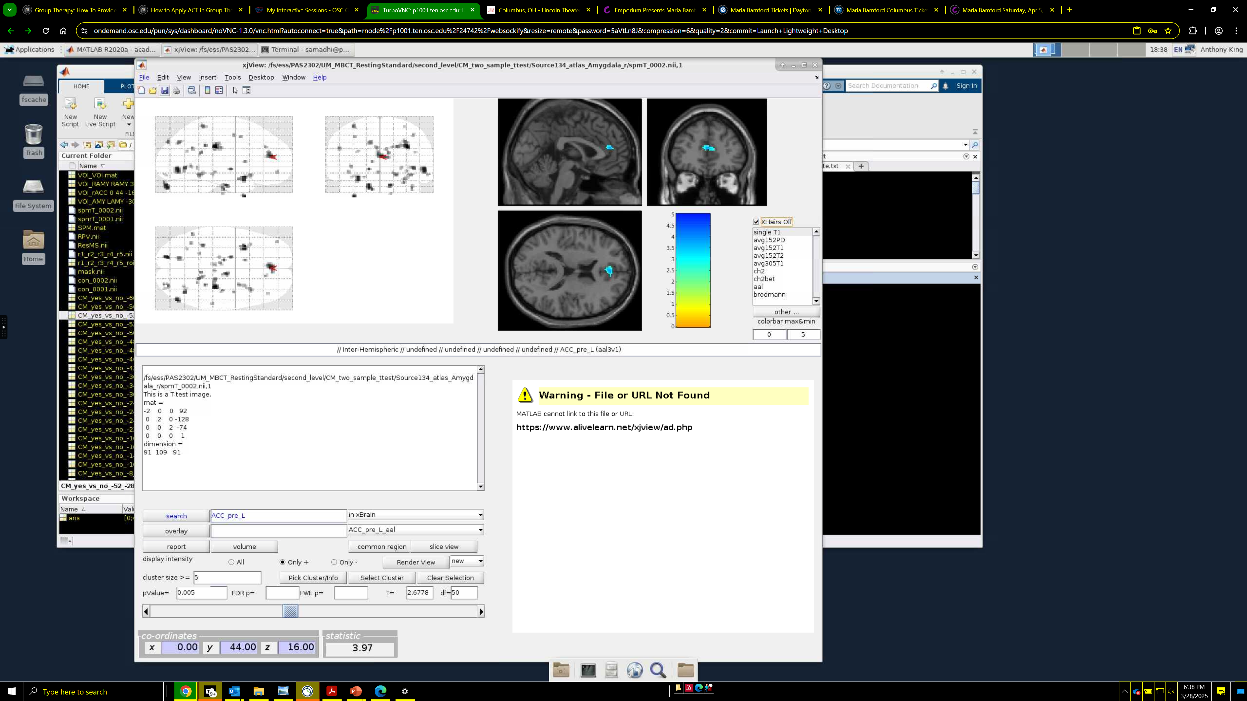
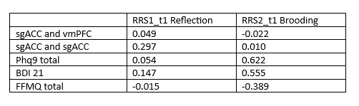
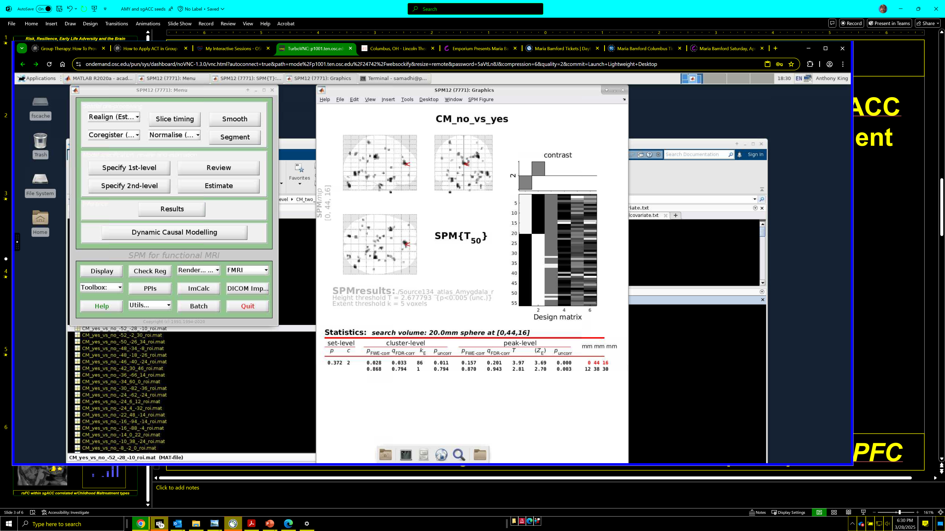

Aberrant Functional Connectivity (rsFC) Between Subgenual ACC and Default Mode Network in Adults with History of Childhood Maltreatment
Arushi Badola¹, Jagan Jimmy¹, Subhashini Madhavan¹, Wenfei Yu¹, Anthony P. King¹
¹Department of Psychiatry and Behavioral Health, The Ohio State University
Background
Methods
Discussion
Childhood maltreatment (CM) involves exposure to physical, sexual, and emotional abuse or neglect^{2,3}.
CM doubles one’s risk of developing MDD in adulthood and is associated with greater MDD symptom severity¹.
Previous studies have linked CM in Major Depressive Disorder (MDD) patients to increased default mode network (DMN) functional connectivity (FC) – a network involved in self-referential thinking and rumination^{4,7}.
Depressive rumination is thought to contribute to increased FC between the ventromedial prefrontal cortex (vmPFC) and subgenual anterior cingulate cortex (sgACC)⁶.
The vmPFC is crucial in regulating the limbic network, specifically the amygdala⁸.
Alterations in FC between the DMN and the salience network (SN) or fronto-parietal network (FPN) have been found in MDD patients with a history of CM⁵.
This study examined the resting-state functional connectivity (rsFC) patterns specific to CM in the DMN, SN and limbic networks in adults to identify the neural correlates of CM.
56 adults with trauma exposure and clinically significant symptoms of PTSD were studied. Twenty of these adults reported history of CM as determined by the Childhood Trauma Questionnaire (CTQ).
3T fMRI scans were collected during resting state. Participants focused on a fixation “plus sign” and let their minds wander freely for 8 minutes.
Seed-based subject level rsFC T-maps were generated using CONN toolbox and entered into second-level random effects model in SPM12 to test the main effects of CM.
Second-level maps were thresholded at p<.005 unc.
Regions of interest (sgACC and vmPFC, rACC and amygdala) were used to examine whether individuals reporting CM differed from individuals reporting no CM in rsFC.
Z-score images from the effects analyses (two-sample t-tests) implemented in SPM12.
Small volume correction used for amygdala rsFC.
Correlational analysis was completed using SPSS.
Adults with current and CM history had increased resting state FC within sgACC and between the sgACC and vmPFC than adults with current PTSD and no history of CM.
sgACC is a node in the limbic network associated with negative affect, and vmPFC a node of the anterior DMN associated with self-referential procession and rumination, suggesting a possible neural mechanism of vulnerability in CM involving increased negativity in self referential processing.
CM history also showed decreased amygdala rsFC with rostral ACC, circuitry associated with emotional regulation, suggesting a possible mechanism of deficits in emotional regulation.
Rumination - Reflection was associated with increased connectivity within the DMN while Brooding was not.
Brooding correlated with depression but Reflection did not.
Correlation of sgACC rsFC with Reflection (rather than Brooding) was not hypothesized, but suggests presence of increased negative bias even in “neutral” repetitive thinking.
This study is relatively small and future studies should investigate the relationship of CM, sgACC-DMN rsFC, rACC-amygdala and rumination / Brooding.
Results
Visualization of expected rsFC with Amygdala
sgACC FC was greater with more forms of CM reported by participants
Increased rsFC between
sgACC seed, vmPFC, sgACC
in adults with CM history
rACC
vmPFC
sgACC
Amygdala
Decreased FC
Increased FC
 | Without CM N=36 |  | With CM N=20
Gender - Female | N=33 | 91.6% | N=18 | 90.0% | ns
Race - White | N=32 | 88.9% | N=17 | 85.0% | ns
 | Mean | SEM | Mean | SEM
Age | 34.5 | 3.5 | 42.3 | 5.0 | ns
CAPS-5 (PTSD) | 29.4 | 1.1 | 32.7 | 1.7 | ns
PCL-5 (PTSD) | 43.5 | 2.4 | 47.5 | 2.6 | ns
BDI (Depression) | 27.3 | 1.7 | 26.9 | 2.6 | ns
RRS - Reflection | 12.0 | 0.7 | 11.0 | 0.9 | ns
RRS2 - Brooding | 13.8 | 0.7 | 14.3 | 0.9 | ns
Self Compassion | 28.6 | 1.4 | 29.0 | 1.7 | ns
AAQ9 - Inflexibility | 41.1 | 1.1 | 40.9 | 1.6 | ns
ERQ - Reappraisal | 24.6 | 1.3 | 24.6 | 1.6 | ns
ERQ - Emotional Suppression | 15.2 | 0.9 | 15.0 | 1.3 | ns
CTQ: Emotional Abuse | 8.3 | 0.7 | 19.2 | 0.5 | <.001
Physical Abuse | 7.1 | 0.3 | 13.2 | 0.9 | <.001
Sexual Abuse | 8.8 | 1.0 | 15.7 | 1.7 | <.001
Emotional Neglect | 9.6 | 0.7 | 18.7 | 1.1 | <.001
Physical Neglect | 7.8 | 0.5 | 12.7 | 0.9 | <.001
Pearson correlation between FC and reflective rumination, and self-report measures and brooding rumination (* <.05, ** <.01, *** <.001)
Decreased rsFC between
Amygdala and rACC
in adults with CM history
*
***
***
**
1. Klumparendt, A., Nelson, J., Barenbrügge, J., & Ehring, T. (2019). Associations between childhood maltreatment and adult depression: a mediation analysis. BMC psychiatry, 19(1), 1-11.
2. Teicher, M. H., Samson, J. A., Anderson, C. M., & Ohashi, K. (2016). The effects of childhood maltreatment on brain structure, function and connectivity. Nature reviews neuroscience, 17(10), 652-666.
3. Hoffmann, F., Viding, E., Puetz, V. B., Gerin, M. I., Sethi, A., Rankin, G., & McCrory, E. J. (2018). Evidence for depressogenic spontaneous thoughts and altered resting-state connectivity in adolescents with a maltreatment history. Journal of the American Academy of Child & Adolescent Psychiatry, 57(9), 687-695.
4. Teicher, M. H., & Samson, J. A. (2016). Annual research review: enduring neurobiological effects of childhood abuse and neglect. Journal of child psychology and psychiatry, 57(3), 241-266.
5. Demirtaş, M., Tornador, C., Falcón, C., López‐Solà, M., Hernández‐Ribas, R., Pujol, J., ... & Deco, G. (2016). Dynamic functional connectivity reveals altered variability in functional connectivity among patients with major depressive disorder. Human brain mapping, 37(8), 2918-2930.
6. Hamilton, J. P., Farmer, M., Fogelman, P., & Gotlib, I. H. (2015). Depressive rumination, the default-mode network, and the dark matter of clinical neuroscience. Biological Psychiatry, 78(4), 224-230.
7. Chou, T., Deckersbach, T., Dougherty, D. D., & Hooley, J. M. (2023). The default mode network and rumination in individuals at risk for depression. Social Cognitive and Affective Neuroscience, 18(1), nsad032.
8. Motzkin, J. C., Philippi, C. L., Wolf, R. C., Baskaya, M. K., & Koenigs, M. (2015). Ventromedial prefrontal cortex is critical for the regulation of amygdala activity in humans. Biological psychiatry, 77(3), 276–284. https://doi.org/10.1016/j.biopsych.2014.02.014
Sphere: functional anatomical region associated with rACC
OSU Mindfulness Lab
mindfulnesslab@osumc.edu
https://u.osu.edu/mindfulnesslab/

